Slide 1
CSC 439/539 Statistical Natural Language Processing Lecture 7: Sequences and Neural Networks
Mihai Surdeanu
Fall 2017

Slide 2
Take-away
Convolutional neural networks
Recurrent neural networks
Long short-term memory networks

Slide 3
Readings
Goldberg, Y. Neural Network Methods for Natural Language Processing.
Available online for UA students at: https://ebookcentral-proquest-com.ezproxy1.library.arizona.edu/lib/UAZ/detail.action?docID=4843762
Olah, C. Conv Nets: A Modular Perspective.
http://colah.github.io/posts/2014-07-Conv-Nets-Modular/
Olah, C. Understanding LSTM Networks.
http://colah.github.io/posts/2015-08-Understanding-LSTMs/

Slide 4
Take-away
Convolutional neural networks
Recurrent neural networks
Long short-term memory networks

Slide 5
Convolutional neural networks (CNN)
How many of you obtained better performance in assignment 2 with bigrams?
Without n-grams, these 2 sentences are similar:
“It was not good, it was actually quite bad.”
“It was not bad, it was actually quite good.”
CNNs capture n-grams in neural networks
They do it cheaply, without the need for an embedding for each bigram.

Slide 6
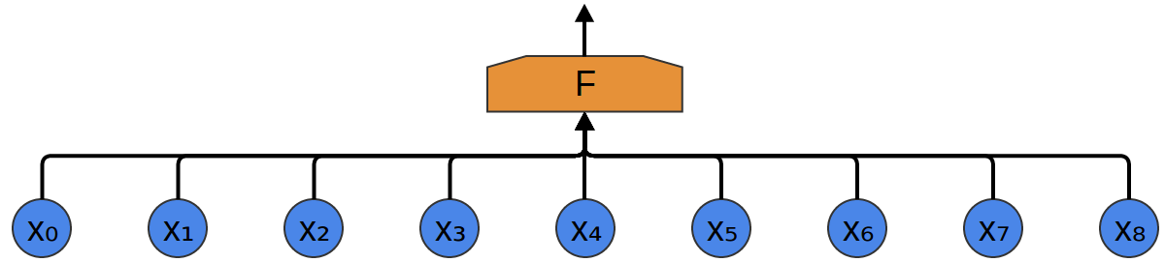
Bag-of-word feed-forward NN
Fully-connected network
Individual words, defined by an embedding of size d_{emb}

Slide 7
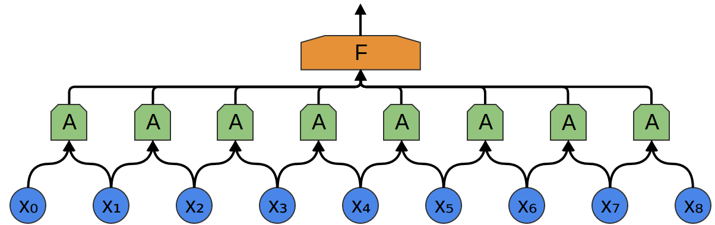
After applying one filter A
Scalar value obtained through a dot product a non-linear activation
Same internal weights used for all applications of A!
What is the size of the weight vector inside filter A?

Slide 8
Exercise
What values do you obtain after applying a sigmoid convolution filter of size 2 with the weights {1, 2, 3, 4} over the following sentence, where each word has an embedding of size 2?
W1: {1, 2}
W2: {2, 2}
W3: {1, 0}
W4: {-1, -2}

Slide 9
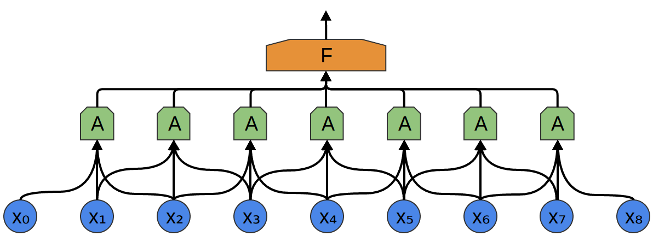
Convolution filter of size k = 3
What is the size of the weight vector inside this filter A?

Slide 10
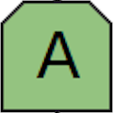
We typically use l different convolution filters
How many columns?
How many rows?
Each green box is a scalar
Each row across the sequence is generated using the same set of internal weights
Notes:
Rows: l
Columns: n - k + 1

Slide 11
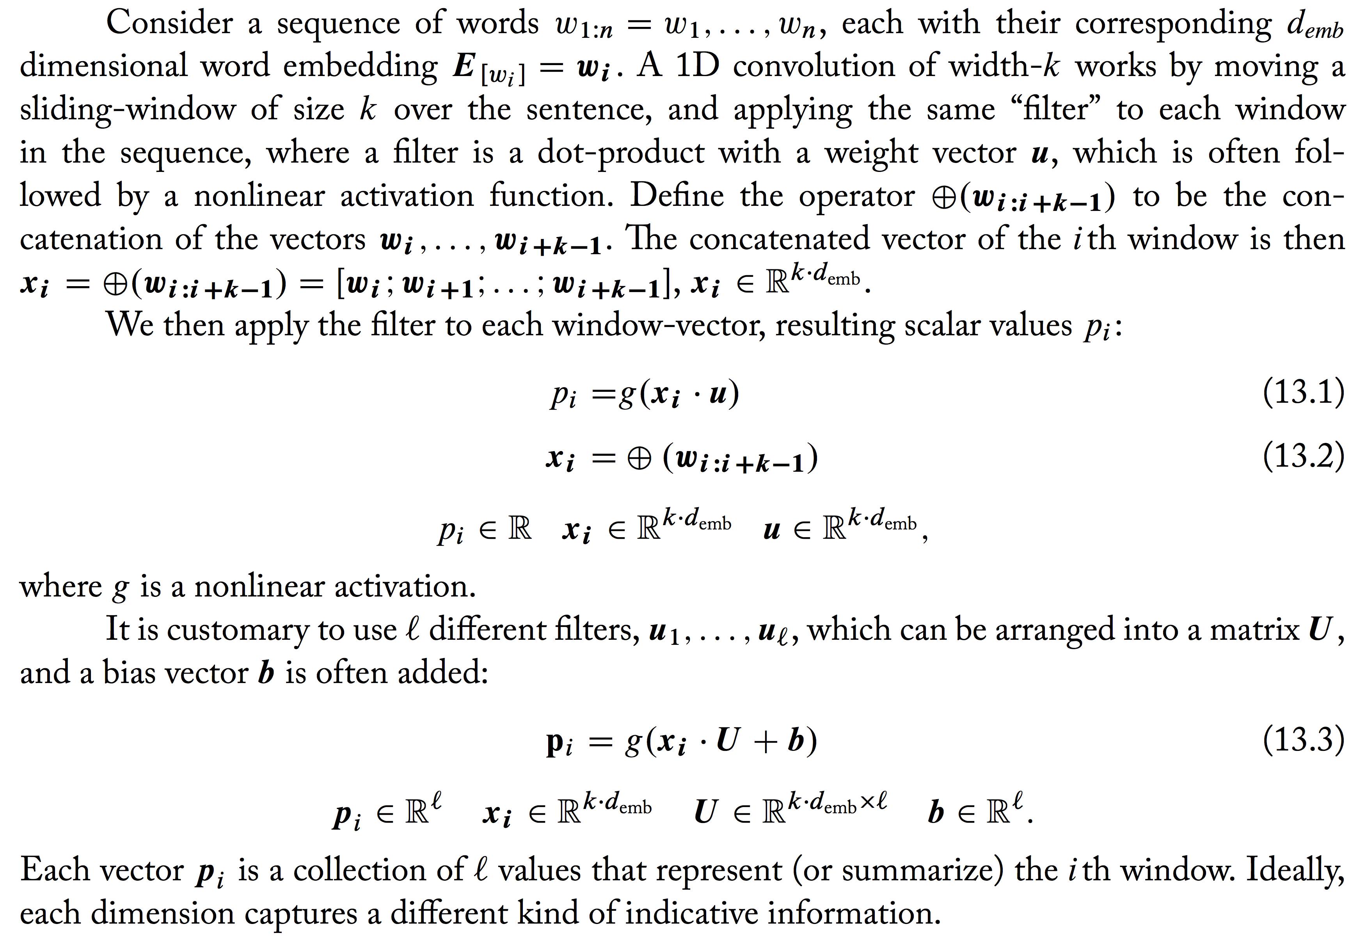
Let’s formalize things

Slide 12
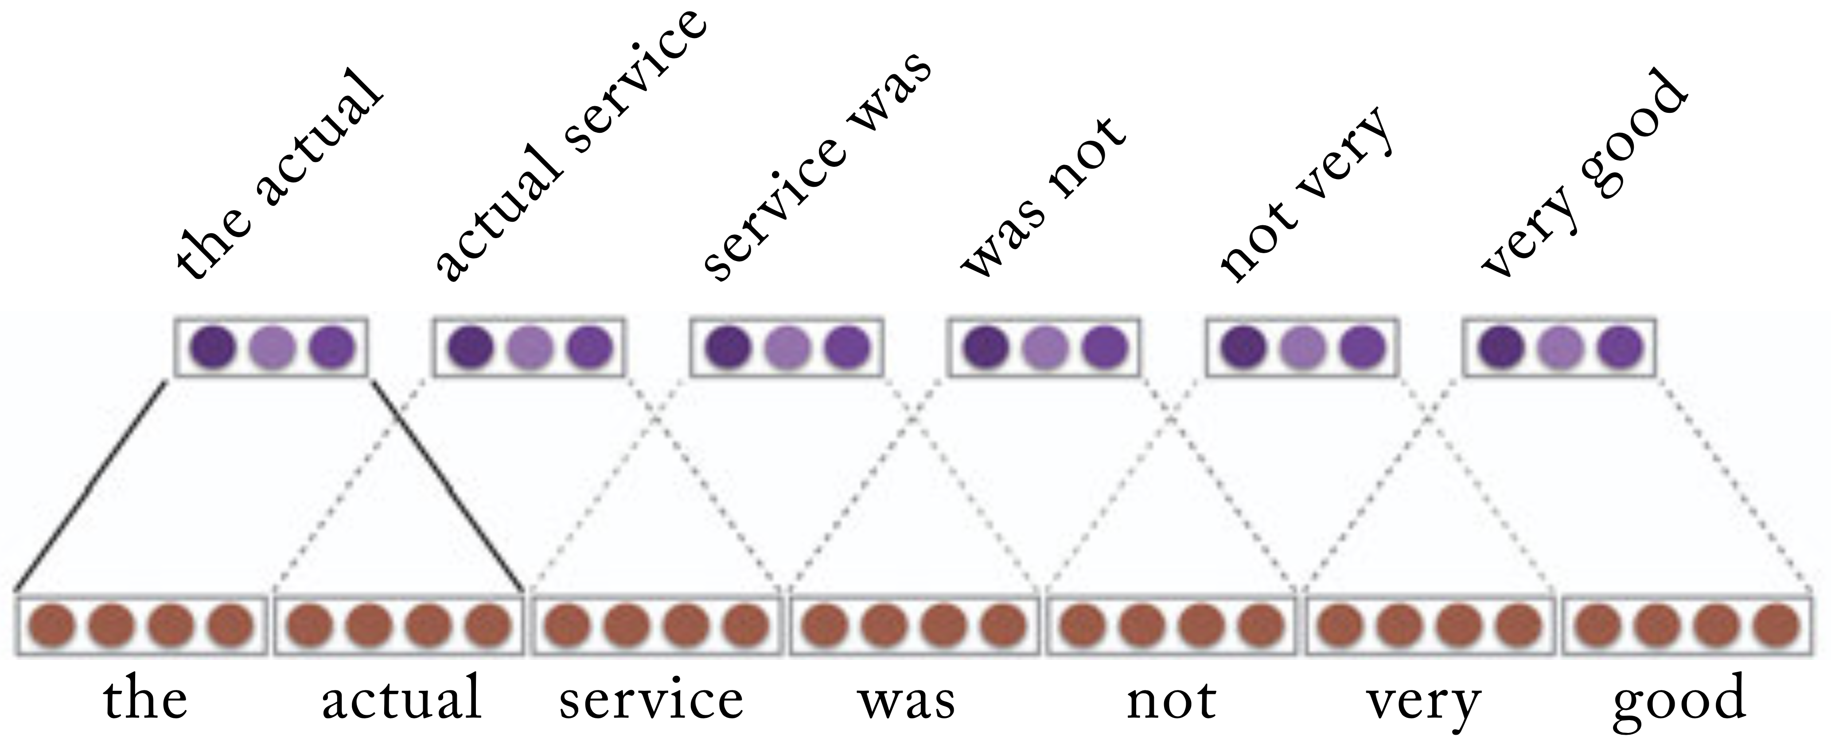
Example
What is the size of the filter matrix U?

Slide 13
Vector pooling
Applying the convolution over the text results in m vectors p_{1:m}, each p_{i} a vector of size l.
These vectors are then combined (pooled) into a single vector c of size l, representing the entire sequence.
Why?

Slide 14
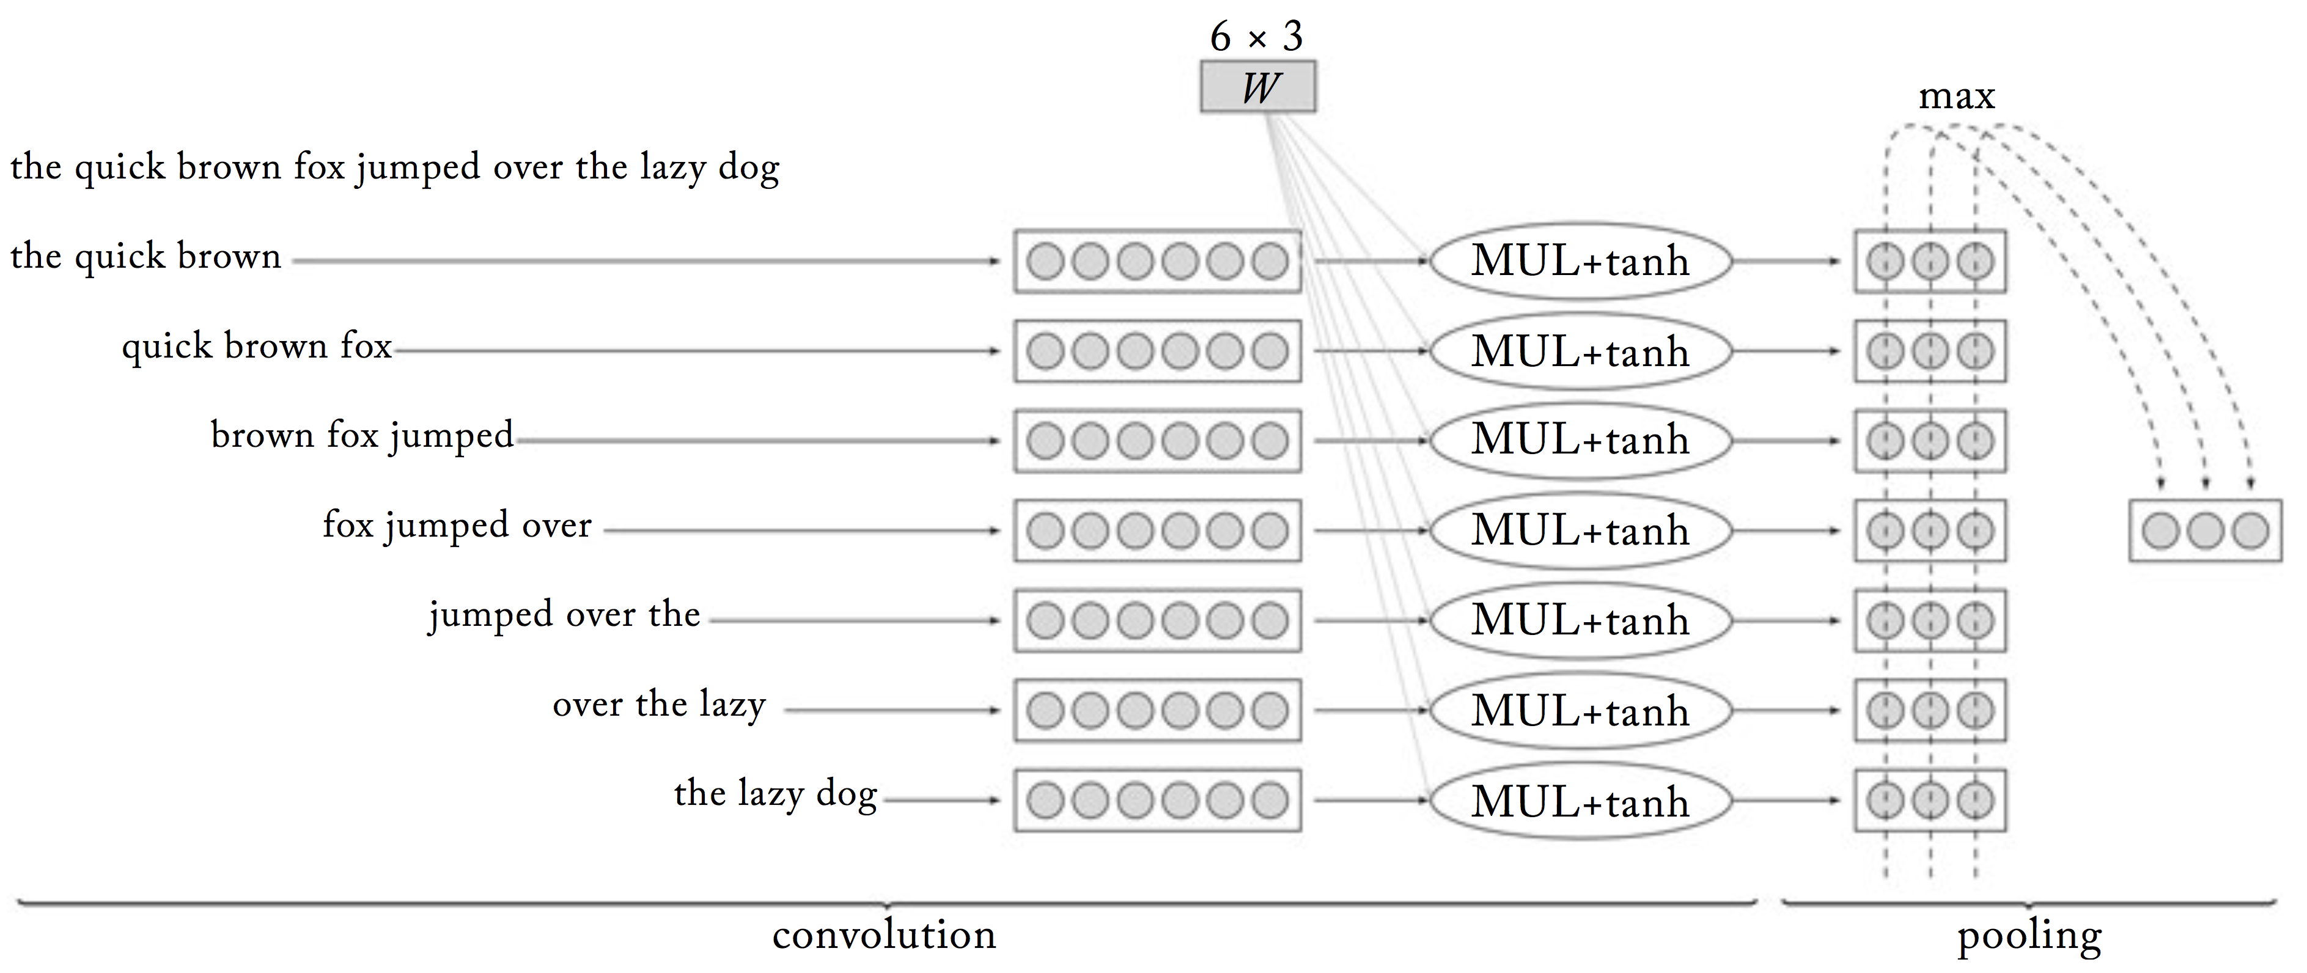
Max pooling

Slide 15
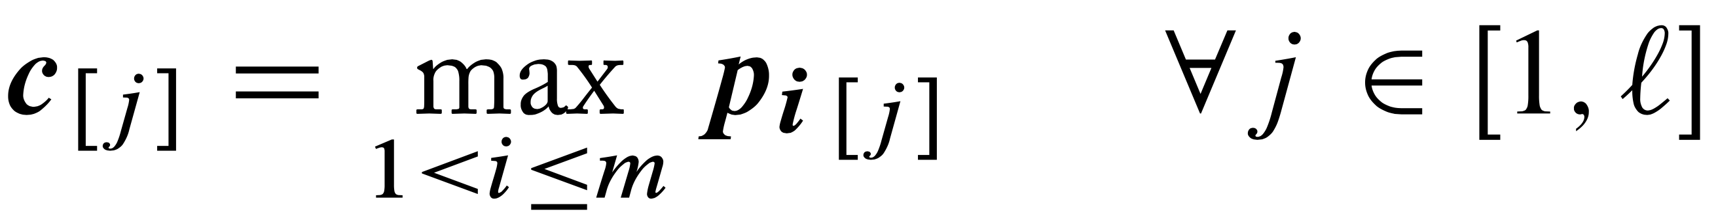
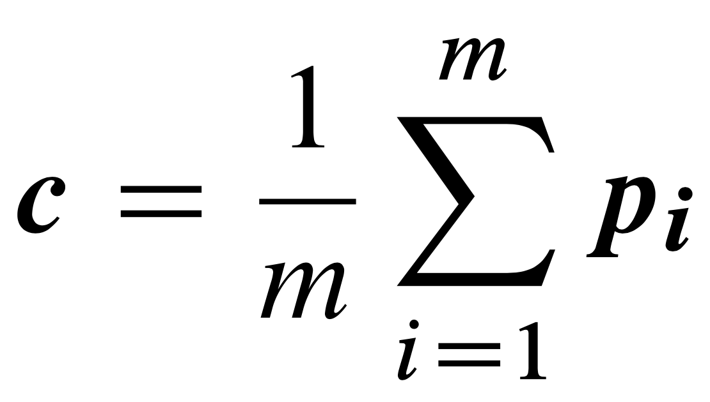
Max and average pooling
Max pooling
Average pooling

Slide 16
Practice Exercise
What vector do you obtain after applying a sigmoid convolution filter of size k = 2, and l = 2 with the weights {{1, 2, 3, 4}, {2, 1, 1, 2}}, together with max pooling, over the following sentence, where each word has an embedding of size 2?
W1: {1, 2}
W2: {2, 2}
W3: {1, 0}
W4: {-1, -2}

Slide 17
Hierarchical convolutions
We can have another convolution on top of the output of the first one!

Slide 18
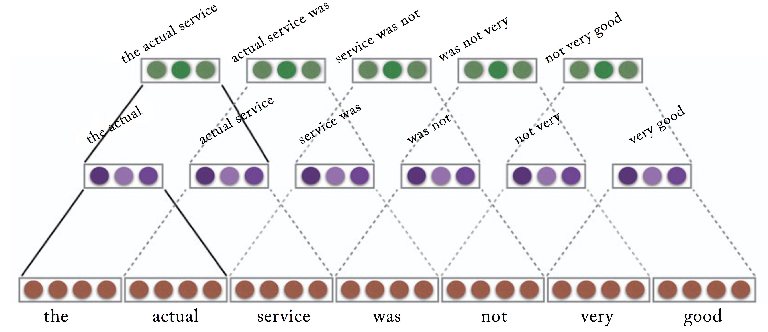
Example
What about this one?
What is the size of the this filter matrix U?

Slide 19
Take-away
Convolutional neural networks
Recurrent neural networks (RNN)
Long short-term memory networks

Slide 20
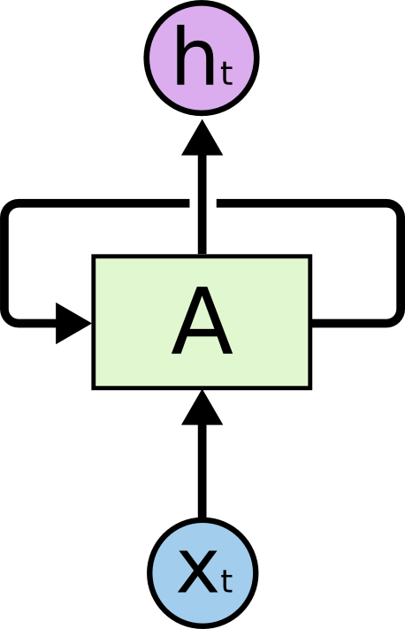
RNNs have loops
“Rolled” representation

Slide 21

Unrolled RNNs
What does this look like?

Slide 22
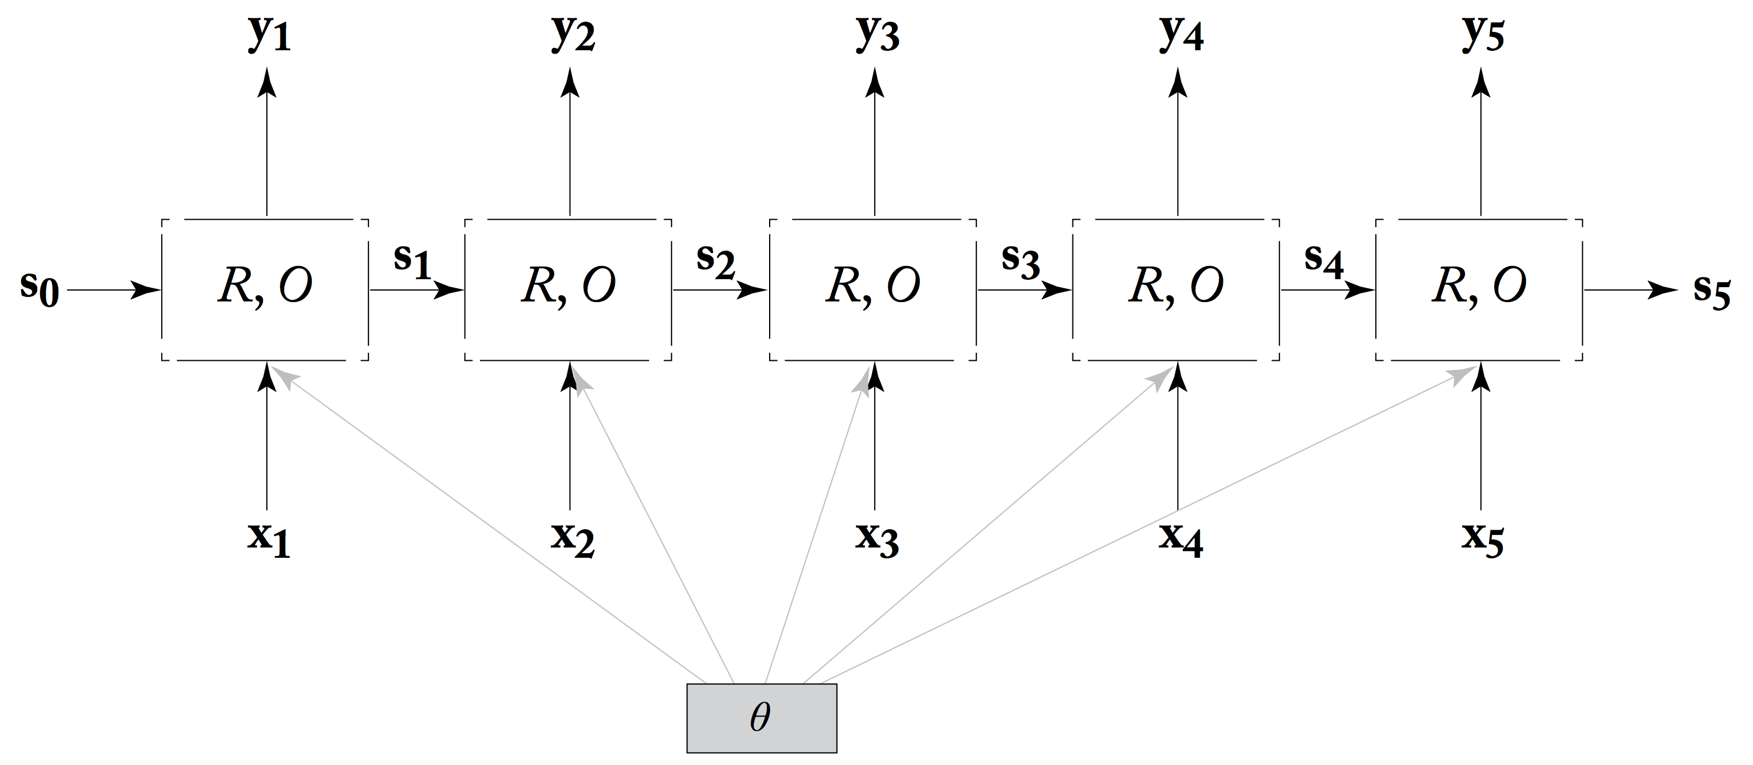
Let’s formalize things

Slide 23
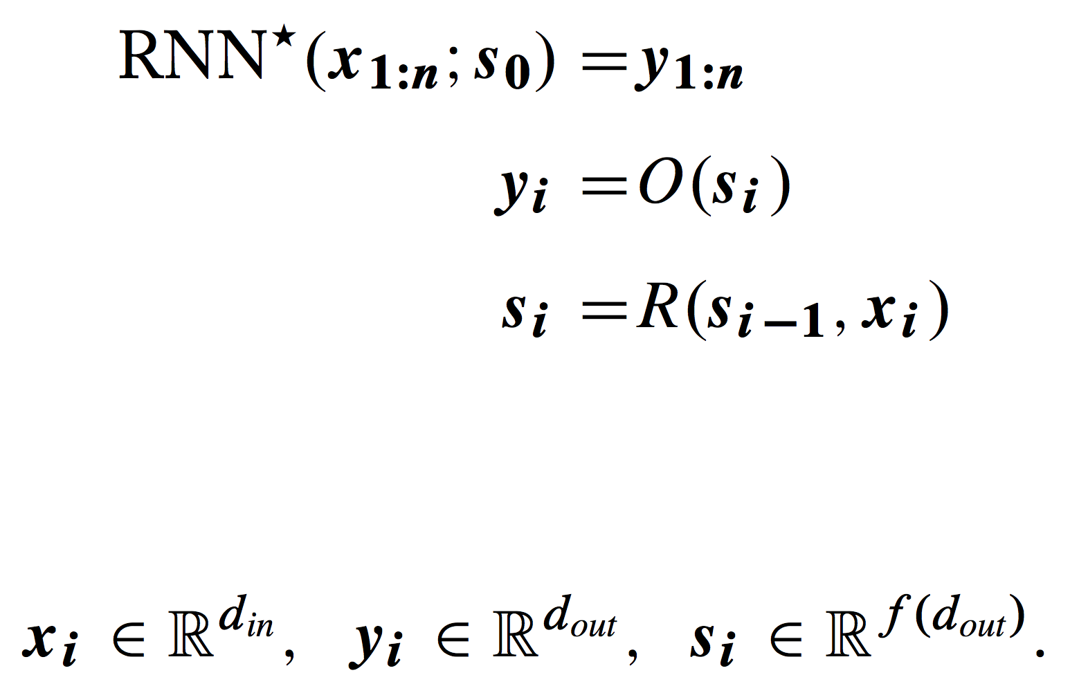
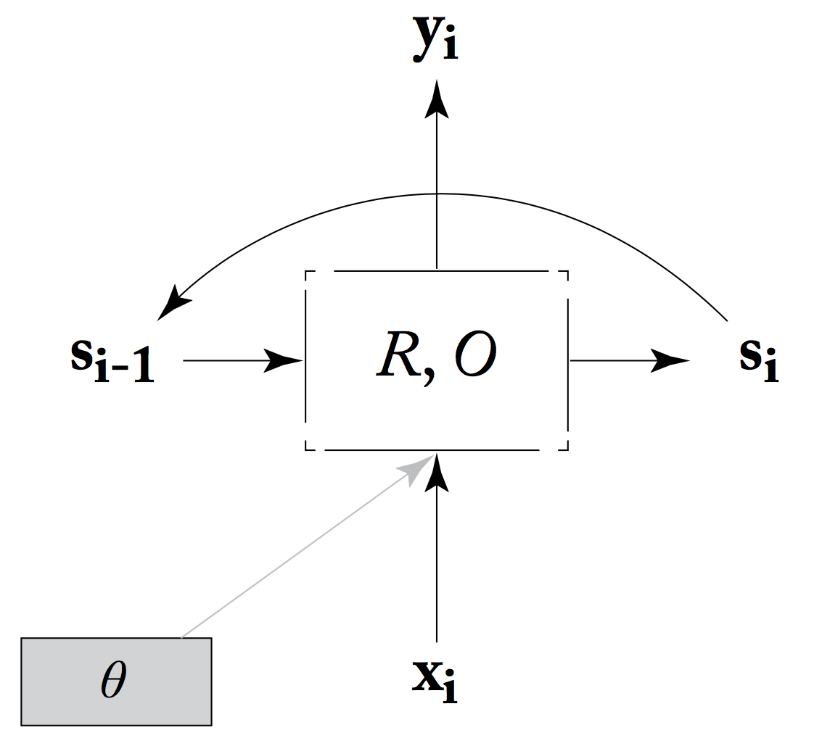
Let’s formalize things

Slide 24
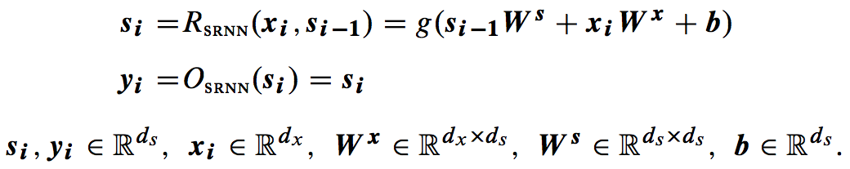
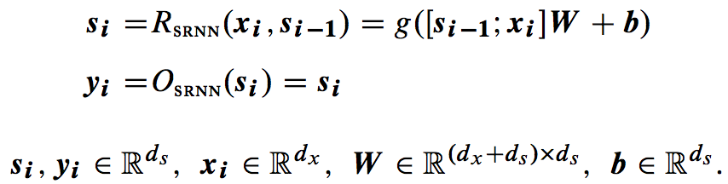
Simple RNN
Alternative but equivalent formulation:

Slide 25
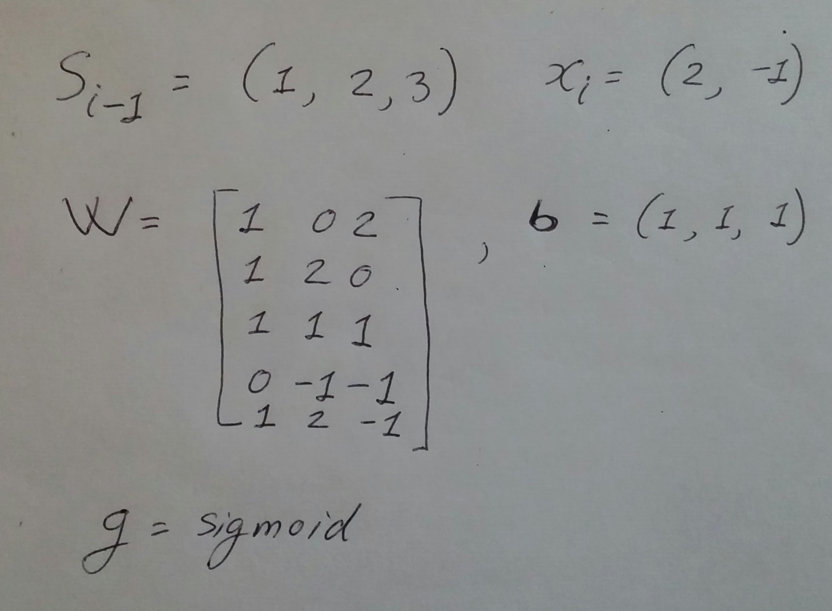
Exercise
Given the simple RNN below, in the alternative notation, and the given state (s_{i-1}) and input (x_{i}), what is the current output y_{i}?

Slide 26
Training
RNNs are just very deep neural networks
What is the problem in this scenario?
Training is the same: backpropagation through time (BPTT)

Slide 27
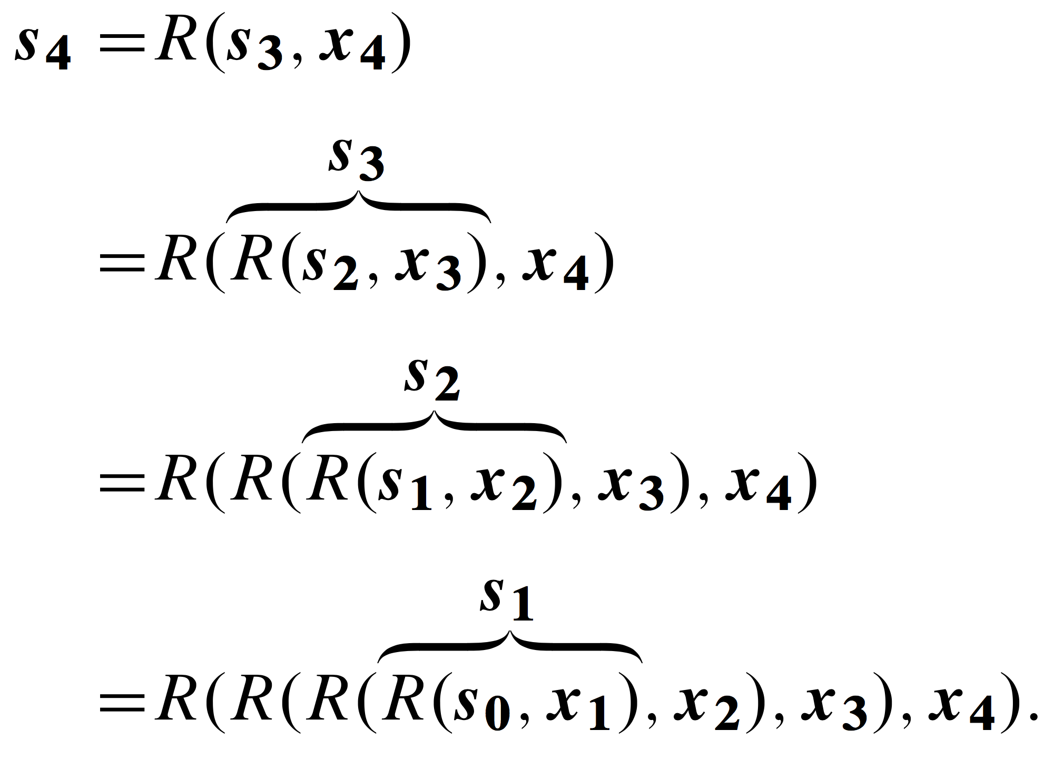
Unlike MEMMs, RNNs do encode the whole sequence

Slide 28
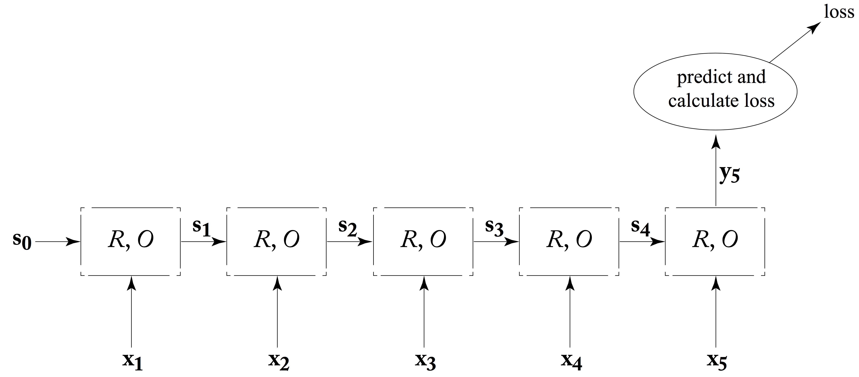
Common RNNs: Acceptor, Encoder
Examples of acceptors?
Encoder: acceptor + follow up model
Encoder example: document summarizer
RNN to generate an encoding of the whole sequence
Separate model to select which sentences/words to include in the summary

Slide 29
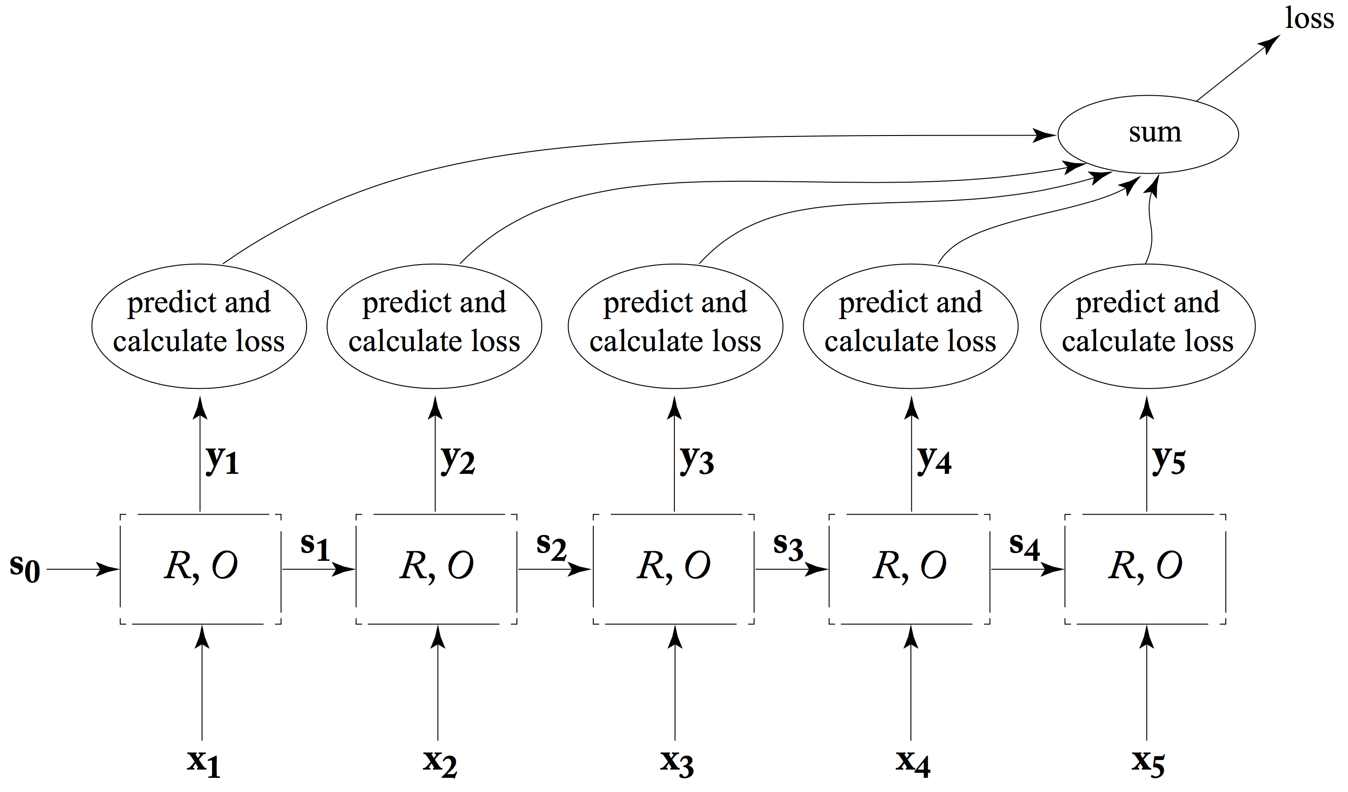
Common RNNs: Transducer

Slide 30
Practice Exercise
Find two examples each of acceptors, encoders, and transducers that are not in NLP
Explain how you would implement them in a RNN

Slide 31
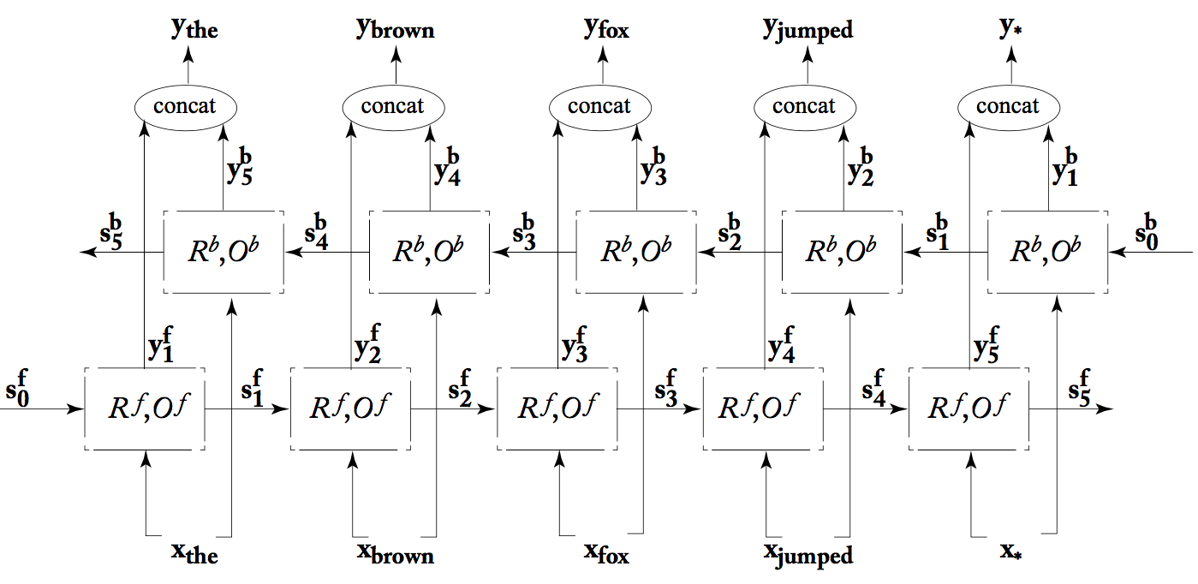
Bidirectional RNNs

Slide 32
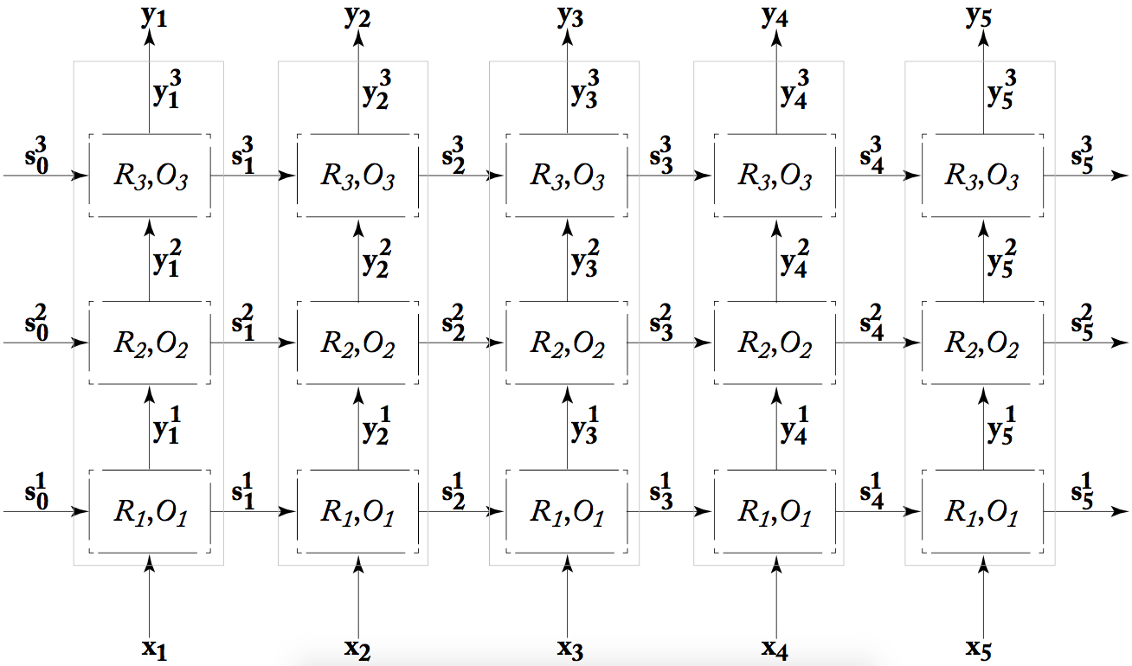
Multi-layer (stacked) RNNs

Slide 33
Take-away
Convolutional neural networks
Recurrent neural networks
Long short-term memory networks

Slide 34
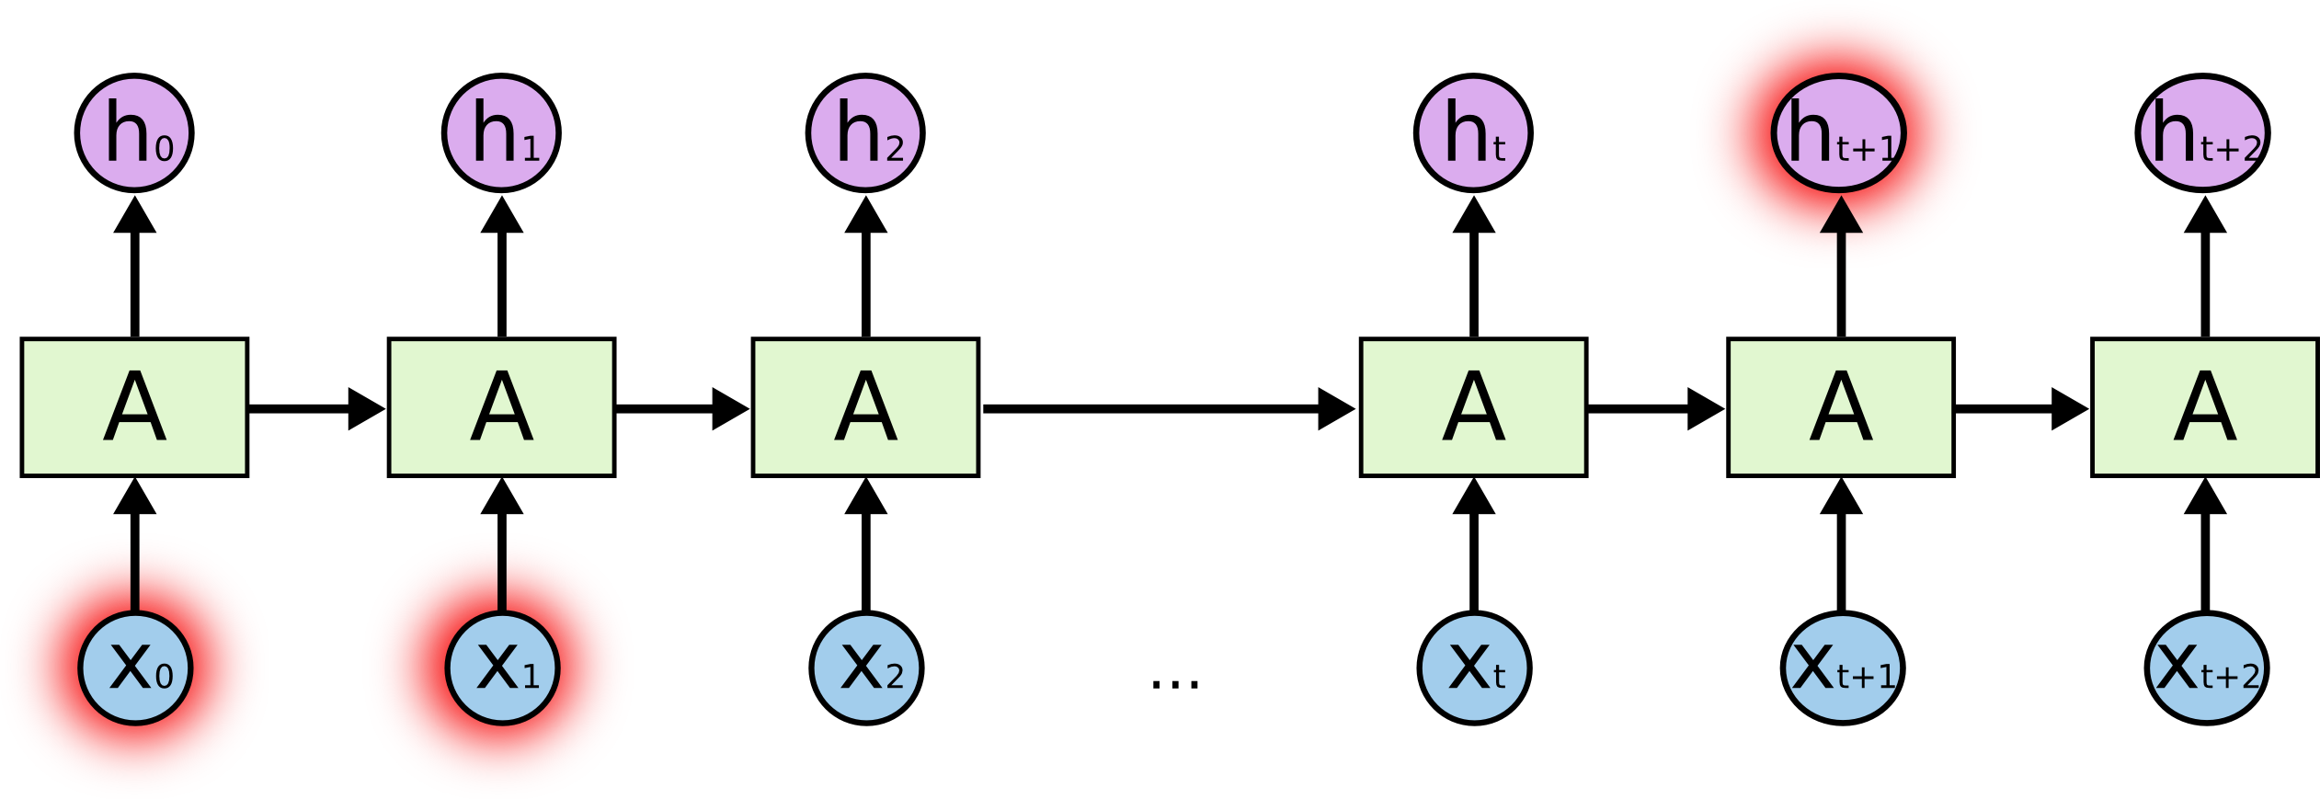
The problem with (vanilla) RNNs
Vanilla RNNs do encode context, but poorly…
The “make something up” example
Or, a language model example: “I grew up in France… I speak fluent French”
Plus, the vanishing gradient problem

Slide 35
LSTMs solve these problems with two advantages
Additive (rather than multiplicative) architectures
Mitigate vanishing gradient problem
They learn what to remember and what to forget from the previous elements
Can remember longer contexts better
Both advantages are implemented using gates
Hence this family of architectures is called gated architectures

Slide 36
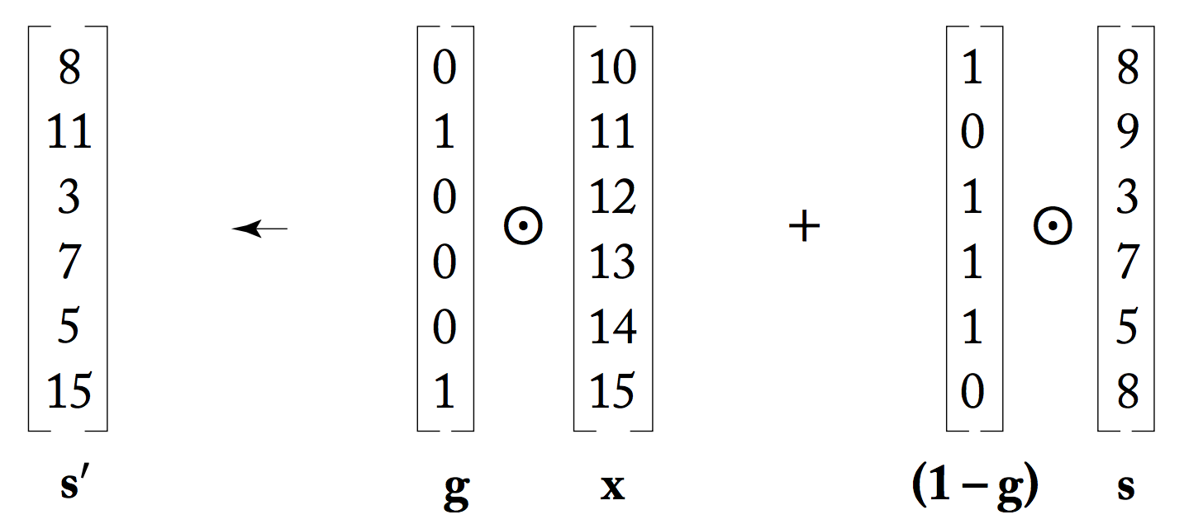
Binary gates
Current state
Current input
Previous state
Binary gate which decides what to keep from input and what from state

Slide 37
In practice: differentiable gates
Arbitrary real numbers, instead of 0s and 1s
Coupled with a sigmoid, so the values to be used are between 0 and 1
These are differentiable, and are trained with the rest of the network!
They are just a component in our new custom architecture

Slide 38
LSTM intuition
LSTMs split the state s into two components:
Memory cell, or cell state (c)
A “conveyor belt” that lets information flow along the entire sequence
Designed to remember/forget across the sequence
Controlled through differentiable gates
Working memory, or hidden state (h)
Combines the current input with the current memory cell and the previous working memory

Slide 39


LSTM overview
Memory cell
Working memory

Slide 40

LSTM walkthrough: forget gate
Decides how much of the previous cell to forget in this node
Vector of numbers in [0, 1] computed based on the current input and the previous working memory

Slide 41
Practice exercise
Given:
h₀ = {1, 2, 1}
x₁ = {2, 1, 3}
W_{f} has dimension 6 x 3, with values all 1
b_{f} = 2
What is the dimension and the values in the f_{t} vector?

Slide 42

LSTM walkthrough: input gate
Input gate which decides what to keep from…
the combination of current input and previous working memory

Slide 43

LSTM walkthrough: cell state
Forgets some of the previous cell
And adds some of the new input (and previous working memory)

Slide 44

LSTM walkthrough: output gate
Decides how much of the cell is relevant for the current working memory == output

Slide 45
LSTM summary
Additive mechanism, which means no vanishing gradients
How much to forget
How much new information to add

Slide 46
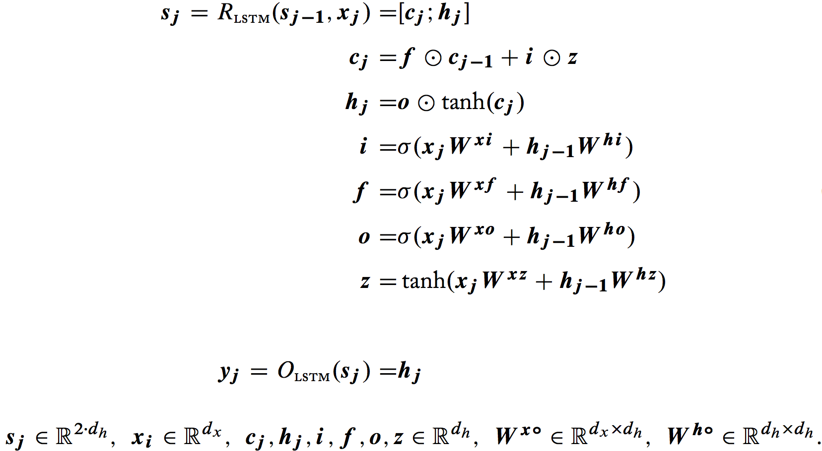
Alternative formulation for LSTMs

Slide 47
LSTMs advantages and disadvantages
They work really really well on many sequence problems in NLP and beyond
But they are kinda complicated…
Plus, they take a long time to train

Slide 48
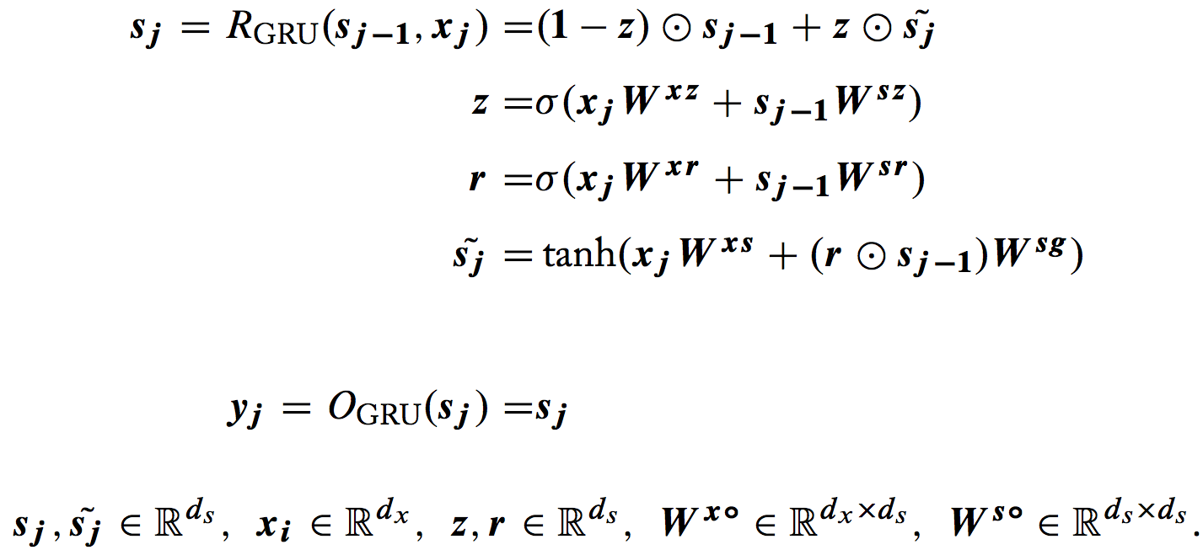
Alternative: Gated Recurrent Units (GRU)

Slide 49
Practice exercise
Design an even simpler gated architecture, with a single gate, which keeps the core advantages of LSTMs and GRUs
Additive memory
Forget mechanism
Hint: start from the GRU and remove things

Slide 50
Take-away
Convolutional neural networks
Recurrent neural networks
Long short-term memory networks

